Slide 1
BHE Equity Lens Update: Early College High Schools
May 2019

Slide 2
Agenda
ECHS Designation Update
Some early evidence on ECHS performance
Emerging National Data
Funding & Legislation Status
Refreshing the Strategic Plan for the Early College Initiative

Slide 3
ECHS Designation Update
Approved a total of 17 ECHS programs now including over 30 high schools;
5 out of 9 state universities;
10 out of 15 community colleges and one private college

Slide 4
Early Promising Evidence
From an “Early College Community of Practice” including four of the original seven designated programs (partial sample of the total cohort of designated ECHSs)
Demographics of participating students
52% female
68% Hispanic; 9% African-American; 8% white; 11% unknown
Credits earned
Fall of 2018 mean credits 4.6; Spring mean 4.7 credits
Means an average of about 3 courses per student/year
Grades earned in Fall 2018
Ranged from A to F; a few W,I, Dropped
Among completers, mean GPA 3.9
Persistence/Retention
89.6% across 11th, 11th and 12th grades

Slide 5
Emerging National Data

Slide 6
The Impact, Costs, and Benefits of NC’s Early College Model
Julie Edmunds, SERVE Center at UNCG
Fatih Unlu and Tiffany Tsai, RAND Corporation
Elizabeth Glennie, RTI International

Slide 7
North Carolina’s model…
Small high schools that blur the line between high school and college
Mostly located on college campuses
Serve students in grades 9-12 or 13
Targeted at students who are underrepresented in college
First generation; low-income; minority
Goal is to get a high school diploma and two years of college credit/Associate degree

Slide 8
Students Graduating from High School Ready for College
Purposeful Design
Professionalism
Personalization
College Ready
Powerful Teaching and Learning
Leadership
Articulated program of study, grades 9-12 or 13 leading to Associate’s degree, college readiness activities
Academic and affective supports, supportive relationships
High-quality, rigorous, and relevant instruction, ongoing assessment
Shared leadership, shared vision
Small size, location on college campus, flexible use of time
Ongoing professional development, staff collaboration, collective responsibility

Slide 9
Experimental Study of the Model’s Impact
Funded by three grants from the Institute of Education Sciences
Twelve-year experimental study comparing students who applied to and were randomly offered a slot in the ECHS with students who applied for and were randomly turned down
Examines the impact of the model on core outcomes: coursetaking, academic performance, behavior, attitudes, dropout, graduation from high school, postsecondary enrollment, college credit attainment, postsecondary performance and postsecondary credentials

Slide 10
Sample
Students apply and schools do some screening
Random assignment within the “eligible population”
Full sample: 19 ECHS, 44 lotteries, 4000 students
Cohorts: 2005-06 through 2010-11
Attrition varies across data sources and outcomes: generally low (<10%) and similar between treatment and control groups.
Low noncompliance with random assignment: 13% no-shows, 2% crossovers
Control students attend “business as usual”

Slide 11
Impact on Postsecondary Credentials: Full Sample
 | Adjusted Treatment Mean | Control Mean | Adjusted Impact, ITT estimate
% Attainment of any postsecondary credential by eight years after 9th grade (N=1671 students) | 37.0 | 22.2 | 14.8**
% Attainment of associate degree | 28.4 | 8.8 | 19.6**
% Attainment of technical credential | 2.2 | 3.0 | -0.8
% Attainment of Bachelor’s degree | 18.1 | 12.8 | 5.3**
*Significant at p≤.05; **significant at p≤.01.
11

Slide 12
Difference between subgroups is statistically significant.
*Significant at p≤.05; **significant at p≤.01.
12

Slide 13
Cost to an educational credential (from Society’s Perspective)
Cost to… | Early College Pathway | Traditional High School Pathway
High school diploma (students with maximum of HS diploma only) | $32,019 | $24,859
HS diploma plus a NC Community College two-year degree | $45,762 | $48,356
HS diploma plus a UNC system four-year degree | $91,192 | $121,626

Slide 14
GPA in the UNC system—after leaving early college
 | Adjusted Treatment Mean | Unadjusted Control Mean | Impact Estimate
Cumulative UNC System GPA
Through two years after 12th grade (grade 14) | 2.60 | 2.56 | .04
Through three years after 12th grade (grade 15) | 2.62 | 2.59 | .03
First semester | 2.78 | 2.71 | .06

Slide 16
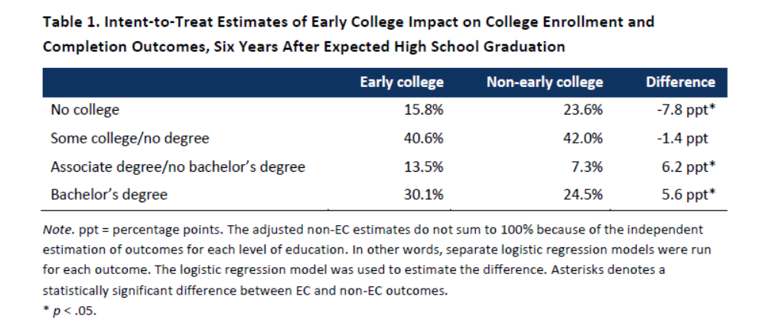

Slide 17
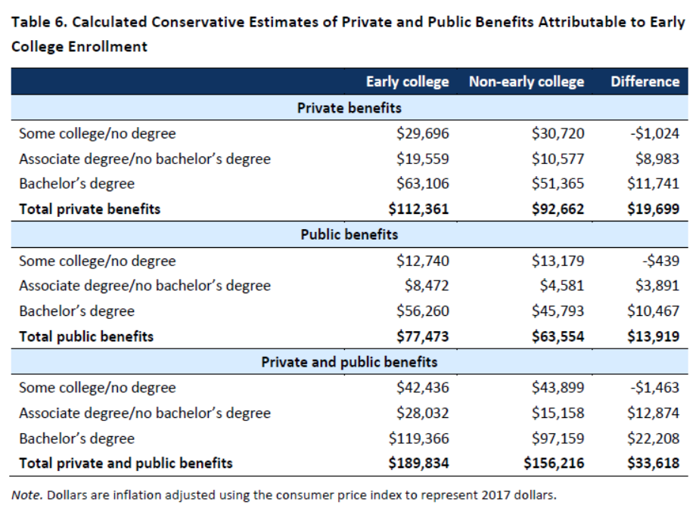

Slide 18
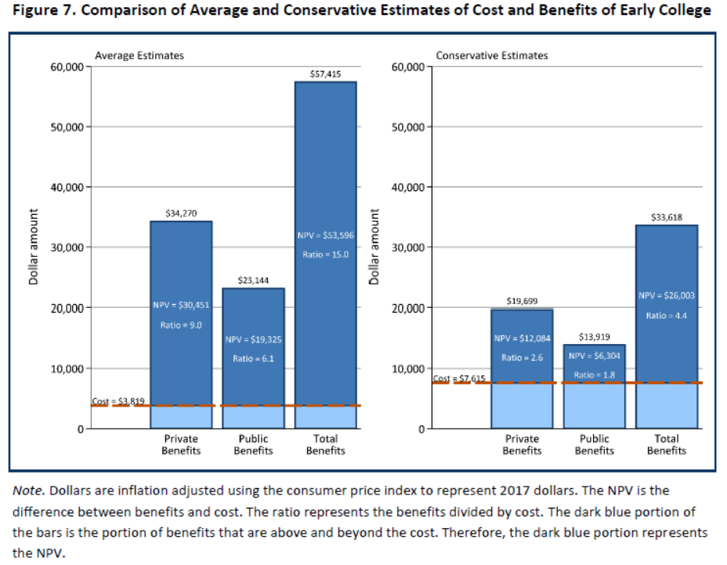

Slide 19
Funding and Legislation Status
EOE Line Item
Chapter 70 Proposal
Trust Fund Proposal
CDEP Funding
Legislation

Slide 20
Refreshing the Strategic Plan for the Early College Initiative
New Position of Early College Director – Kristin Hunt
Connect Original Intent of EC Initiative, First Generation of Designation Criteria with emerging evidence from pioneer ECHSs, national data and growing Massachusetts ecosystem

